Slide 1

Driving forces behind internet adoption
Nazim Ashman

Slide 2
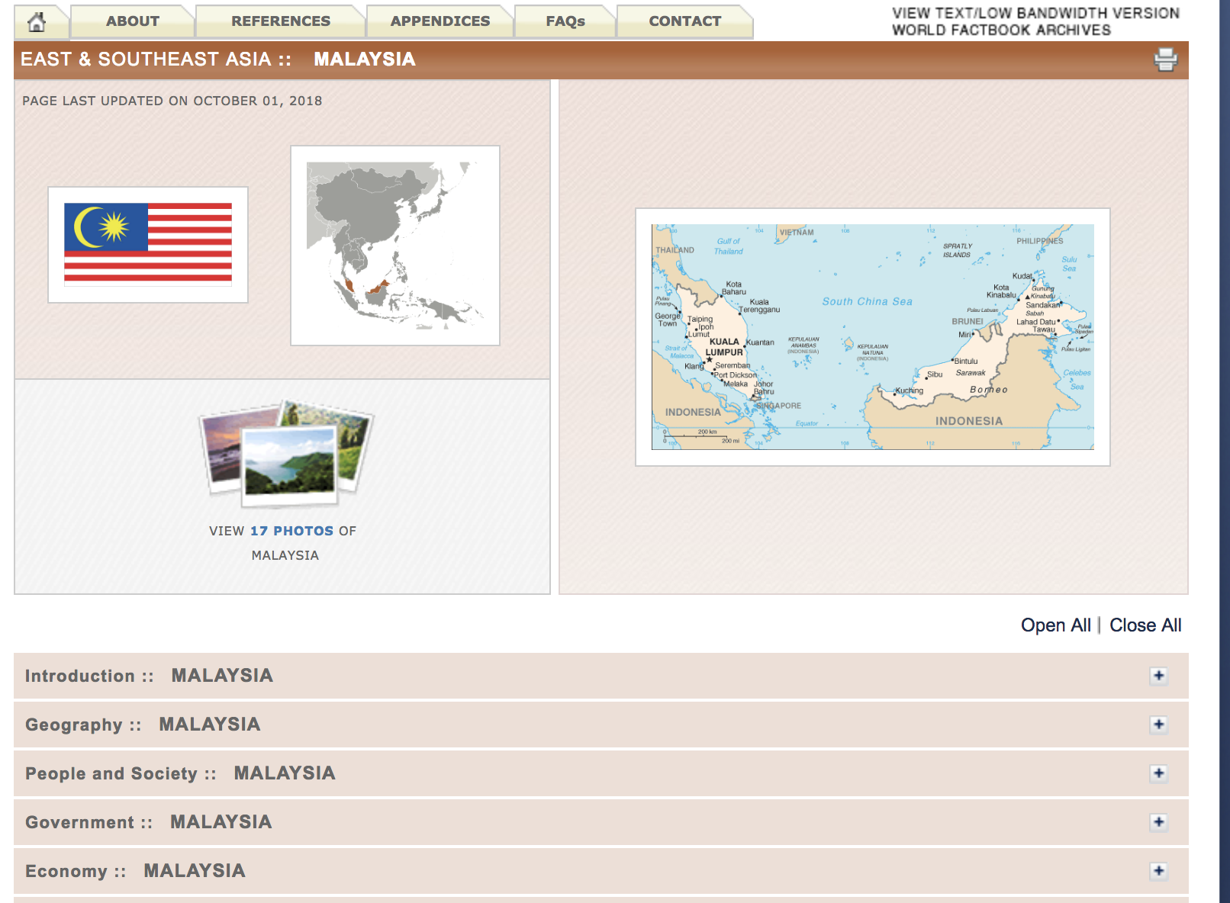
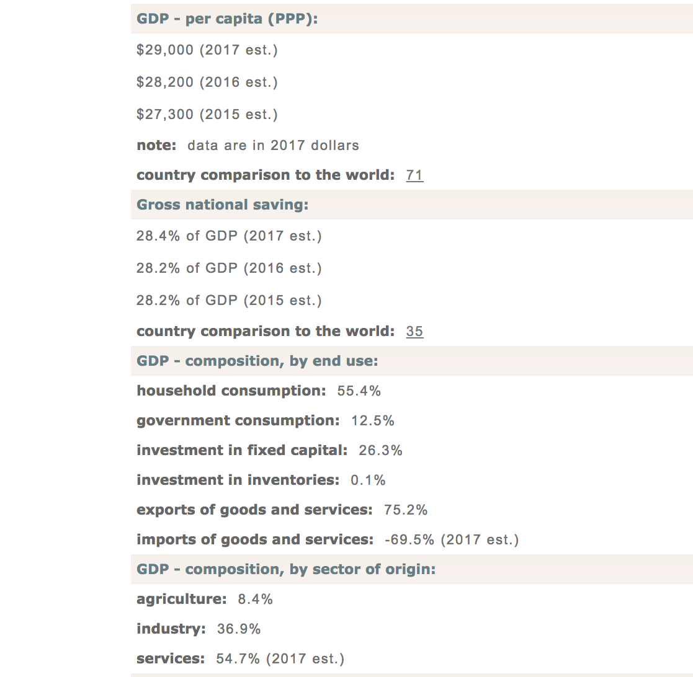
The Data
Source: CIA Worldfactbook
Notes:
Exploring the driving factors behind internet adoption in countries.
I have gathered country data from CIA Worldfactbook.
List of initial features: GDP per capita, Unemployment rate, Population below Poverty, Population, Education Expenditure, Infant Mortality, % of Economy in agriculture, industry and services, total telephones (cellular and landline), education expenditure. Internet user density in bordering countries.

Slide 3
Initial features and expectations
Features:
GDP per capita, unemployment rate, population below poverty, population, education expenditure, % of economy in agriculture, industry and services, total telephones (cellular and landline), education expenditure and internet users in bordering countries.
Expectations:
Number of mobile/landline devices, represents a high amount of communication.
Richer more developed countries likely to be higher.

Slide 4
Correlations

Slide 5
P-values for all features
Feature | P>(t)
Education expenditure | 0.366
GDP per capita | 0.126
Population in Poverty | 0.001
Population | 0.324
Public Debt | 0.574
Unemployment Rate | 0.571
Urbanization | 0.098
% of GDP from Agriculture | 0.000
% of GDP from Industry | 0.005
Internet Users in Bordering Countries | 0.052
Exports + Imports | 0.777
Mobile + Landline device | 0.405

Slide 6
P-values for all features
Feature | P>(t)
Education expenditure | 0.366
GDP per capita | 0.126
Population in Poverty | 0.001
Population | 0.324
Public Debt | 0.574
Unemployment Rate | 0.571
Urbanization | 0.098
% of GDP from Agriculture | 0.000
% of GDP from Industry | 0.005
Internet Users in Bordering Countries | 0.052
Exports + Imports | 0.777
Mobile + Landline device | 0.405

Slide 7
P-values for all features
Feature | P>(t)
Education expenditure | 0.366
GDP per capita | 0.126
Population in Poverty | 0.001
Population | 0.324
Public Debt | 0.574
Unemployment Rate | 0.571
Urbanization | 0.098
% of GDP from Agriculture | 0.000
% of GDP from Industry | 0.005
Internet Users in Bordering Countries | 0.052
Exports + Imports | 0.777
Mobile + Landline device | 0.405

Slide 8
Removing collinearities features
GDP per capita and Exports + Imports are collinear.
Urbanization and % GDP from Agriculture are collinear.
Remove Exports + Imports and Urbanization
Feature | P>(t)
GDP per capita | 0.000
Internet Users in Bordering Countries | 0.000
% of GDP from Agriculture | 0.000
Population in Poverty | 0.000

Slide 9
Polynomial selection and cross validation
Notes:
Label the graphs

Slide 10
Elastic net regularization: 2nd degree
Optimum alpha of 0.001.
R² of 0.76 on test set.
Final coefficients:
Feature | Coefficient
% GDP from Agriculture | 0.412
GDP per capita | 0.359
Population under poverty | 0.277
Internet users in bordering countries | 0.049
(Internet users in bordering countries)² | 0.201

Slide 11
Conclusions
Low % of economy in agriculture.
Richer countries have higher internet base.
Overall living conditions.
Internet culture in neighboring countries.
Notes:
Countries which produce more in services and industry as oppposed to agriculture have a larger internet userbase. These industries require more of an internet presence also.
High agriculture also = high rural population and less urban, difficult to connect.
Richer countries have higher internet base. Richer countries can spend more on crucial infrastructure. Population have a higher income to spend on internet services.
Living standards in a country matter, countries with a higher amount above the poverty line have a higher internet userbase.
Neighboring countries may have a large internet culture. Cultures/lifestyles of neighboring countries are likely to be similar and hence their internet adoption patterns are likely to be similar.
Maybe find some examples.

